Slide 1

Build Management

Slide 2
It is process of compiling and assembling a software system.
Build automation is the act of scripting or automating a wide variety of tasks
-compiling source code
-packing binaries
-Running automated tests.
-Deploying to production
-Creating Document

Slide 3
Maven
Maven is a project management tool which encompasses a project object model, a set of standard, a project lifecycle, a dependency management system, and logic for executing plugin goals at defined phases in a lifecycle”.
Maven provides supersets of features found in a build tool
Maven manage project build tool, reporting, and documentation from a central piece of information.
Maven is open source
Maven build on Java.. Used for java project
Maven uses java to run

Slide 4
Building a software project typically consists of such tasks as downloading dependencies, putting additional jars on a classpath, compiling source code into binary code, running tests, packaging compiled code into deployable artifacts such as JAR, WAR, and ZIP files, and deploying these artifacts to an application server or repository.
Apache Maven automates these tasks, minimizing the risk of humans making errors while building the software manually and separating the work of compiling and packaging our code from that of code construction.

Slide 5
Why Use Maven?
The key features of Maven are:
simple project setup that follows best practices: Maven tries to avoid as much configuration as possible, by supplying project templates (named archetypes)
dependency management: it includes automatic updating, downloading and validating the compatibility, as well as reporting the dependency closures (known also as transitive dependencies)
isolation between project dependencies and plugins: with Maven, project dependencies are retrieved from the dependency repositories while any plugin's dependencies are retrieved from the plugin repositories, resulting in fewer conflicts when plugins start to download additional dependencies
central repository system: project dependencies can be loaded from the local file system or public repositories, such as Maven Central

Slide 6
Project Object Model
The configuration of a Maven project is done via a Project Object Model (POM), represented by a pom.xml file. The POM describes the project, manages dependencies, and configures plugins for building the software.

Slide 7
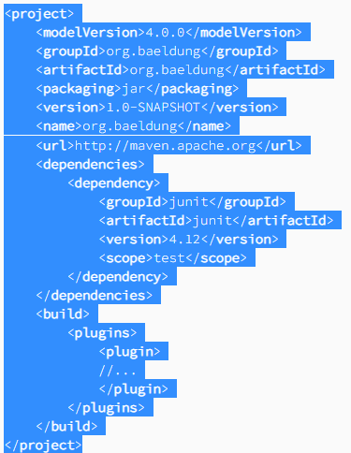
POM Structure

Slide 8
Maven → goals→ plugins →tasks
Our goal is compile .. Then it uses compile plugin and perform a task
In Maven we are uses different plugin

Slide 9
Main Features Of Maven
Build tool
Dependency Management Tool
Documentation Tool

Slide 10
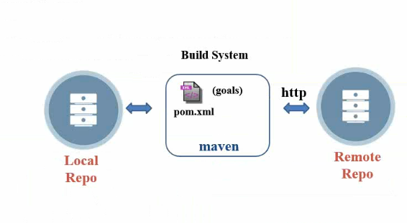
Maven Architecture

Slide 11
Main Configuration File – pom.xml
1. list of source – project source file
2. list of re-sources –plugin/dependency
Maven compile java file and convert it into class file

Slide 12
Maven Lifecycle
A Maven build follow a lifecycle
Default lifecycle
- 1)Generate source /Generate-resources - list of source and plugin/dependencies
- 2)Compile → covert .java file to .class (object file)
- 3)Test → running Junit test cases
4)Package → creating - Jar/war/ear
5)Install →mvn:install copies your packaged Maven module to your local repository
6)Deploy → mvn:deploy uploads your packaged Maven module to another (usually remote) repository, to be accessed by other, not necessarily local, Maven builds.
There is also a Clean, Site lifecycle..

Slide 13
Maven→goals→plugins→tasks
Compile
1.java →1.class
2.java→2.class
Test
Test1.java→Test1.class
Executing junit test cases
Package →jar|war|ear
app.jar, app.war, app.ear

Slide 14
Package Vs Install
package will compile your code and also package it. For example, if your pom says the project is a jar, it will create a jar for you when you package it and put it somewhere in the target directory (by default).
install will compile and package, but it will also put the package in your local repository. This will make it so other projects can refer to it and grab it from your local repository.

Slide 15
Install vs Deploy
Install – Its copy artifact in local repo
Deploy – Its deploy artifact on remote

Slide 16
Clean and site
Clean – Its cleaning our local repository.
Its remove all runtime files
Site – It helps to create documentation of project

Slide 17
Examples of Maven Goal
mvn install → invoke generate* and compile, test, package, integration-test, install
mvn clean →invoke just clean
mvn clean compile → Clean old builds and execute generate and compile.
mvn compile install → invoke generate, compile, test, integraiotn-test, package, install.
mvn test clean → Invokes generates* , compile, test and then clean.

Slide 18
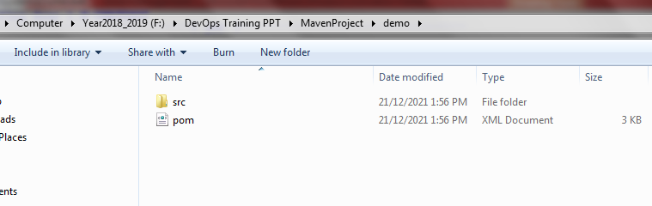
Create Maven Dummy Project
Go to cmd prompt and execute below command
#mvn archetype:generate

Slide 19
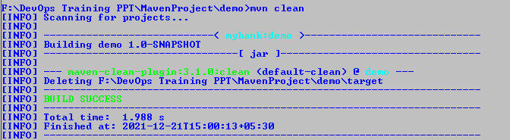
#mvn clean
Its clean project target directory

Slide 20
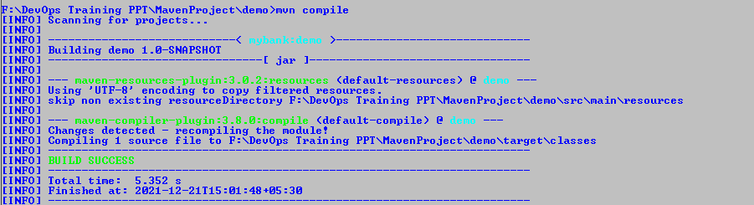
#mvn compile
Its compile java files and creating class file..

Slide 21
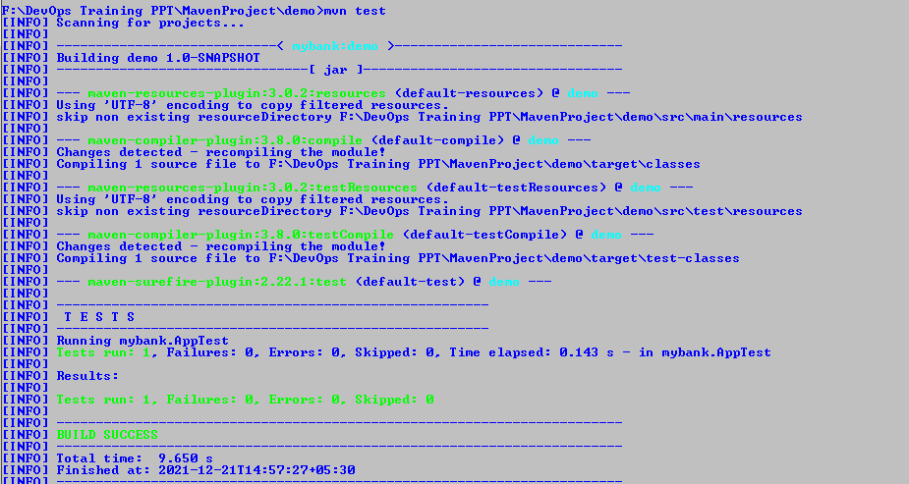
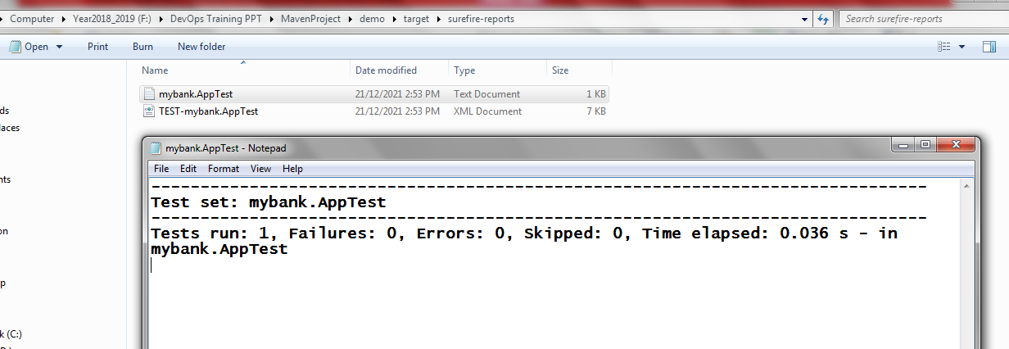
#mvn test
Its placing test report in target folder..

Slide 22
#mvn package
Its creating jar file and keeping in our project target folder of same project.

Slide 23
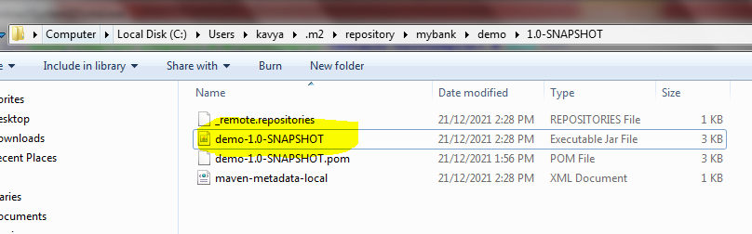
#mvn install
Install artifact in local maven repository.
Our local maven repo location as below

Slide 24
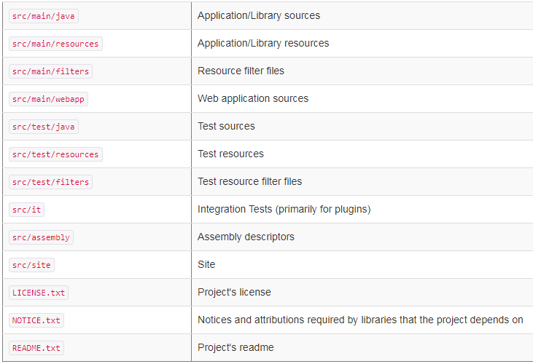
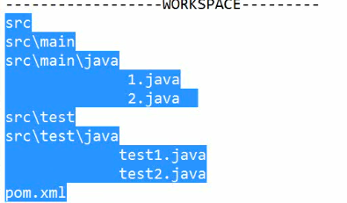
Standard Directory Layout

Slide 25
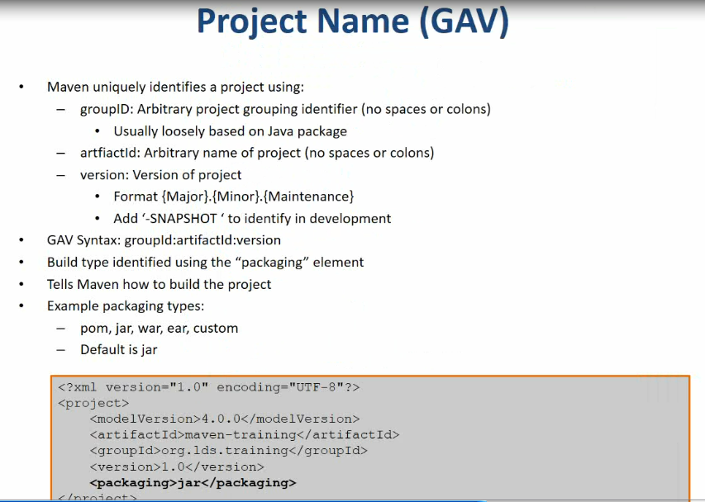
POM File

Slide 26
POM File
Company name:
Group ID: Company Name
Artifact Id: demo →Project Name
Version: Version Number
GAV : graoupid:artifactid:version

Slide 27
Maven Installation
Download binaries from https://maven.apache.org/install.html
The installation of Apache Maven is a simple process of extracting the archive and adding the bin folder with the mvn command to the PATH.
Windows:
Adding to PATH: Add the unpacked distribution's bin directory to your user PATH environment variable by opening up the system properties (WinKey + Pause), selecting the “Advanced” tab, and the “Environment Variables” button, then adding or selecting the PATH variable in the user variables with the value C:\Program Files\apache-maven-3.8.4\bin. The same dialog can be used to set JAVA_HOME to the location of your JDK, e.g. C:\Program Files\Java\jdk1.7.0_51
Open a new command prompt (Winkey + R then type cmd) and run mvn -v to verify the installation.

Slide 28
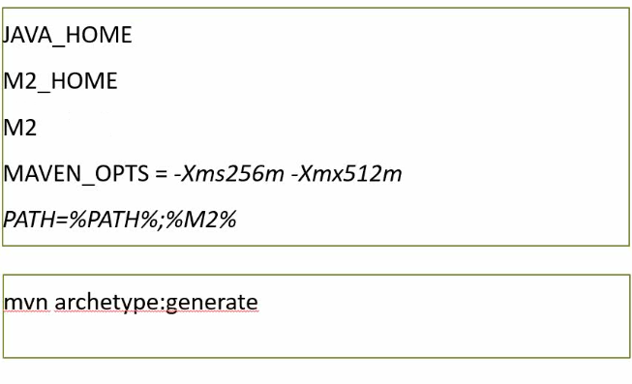
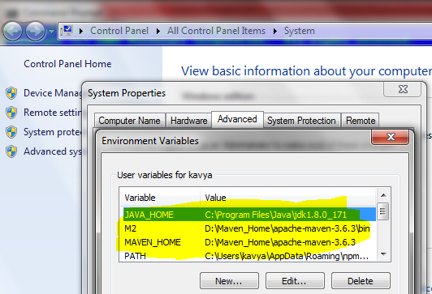
Maven Environment Setup

Slide 29
Maven Repository
Dependencies are downloaded from repositories –via http
Downloaded dependencies are cached in a local repository – Usually found in ${user.home}/.m2/repository
Repository follows a simple directory structure
-{groupid}/{artifactid}/{version}/{artifactid}-{version}.jar
-groupid ‘.’ is replaced with ‘/’
Maven Central is primary community repo
https://repo1.maven.org/maven2/

Slide 30
POM
What is POM?
POM stands for project object model
As a fundamental unit of work in Maven, POM in XML file that contain information about project and configuration details used by Maven to build the project.
>> Describe as a project
Name and Version
Artifact Type
Source Code locations
Dependencies
Plugins
Profiles(Alternate Build Configurations)
Uses XML by Default
Not the way Ant uses XML

Slide 31
Maven Plugin Mgmt
https://maven.apache.org/plugins/index.html

Slide 32
What is maven plugin
Plugin is one of the vital features that is basically used to reuse the common build logic across different projects.
Plugins are the ones through which all the tasks like compiling code, testing them with the Junits, creating jar/war/ear files and documentation of the projects are carried out.
Maven is nothing but a plugin execution framework in which every tasks are accomplished by usage of plugins.

Slide 33
Types of plugin
Basically 2 types of plugin exists in maven
1)Build Plugins: These plugins will execute during the build phase. These plugins are identified under the build element in pom.xml
2)Report Plugins: These plugins are executed during the site generations(report or javadocs generations) phase. These plugins will be configured under the <reporting> element in pom.xml

Slide 34
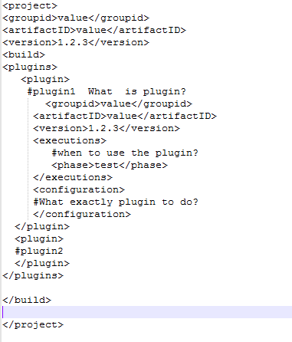

Slide 35
Settings.xml
File location: Its placed in maven home directory (conf).
We can change local repo and other details in this file.
Something to define globally.
We can override this with our settings.xml

Slide 36
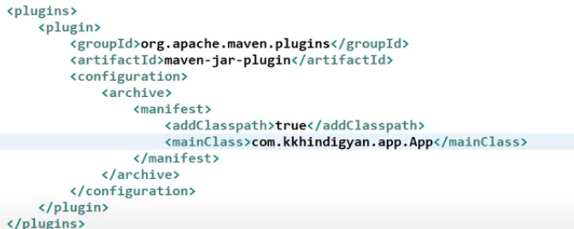
Executable Jar
Error: No main mainfest file
Add below plugin

Slide 37
How to Manage External Jar
All the basic list of dependencies in maven is handled by the maven central repository at which a project download the required dependencies
There will be certain scenario at which some particular dependencies may not be available in the maven remote and central repositories.
Maven still answer this scenario by providing the feature of external dependency management.
In maven, any external dependencies can be easily configurable as other dependencies in the pom.xml

Slide 38
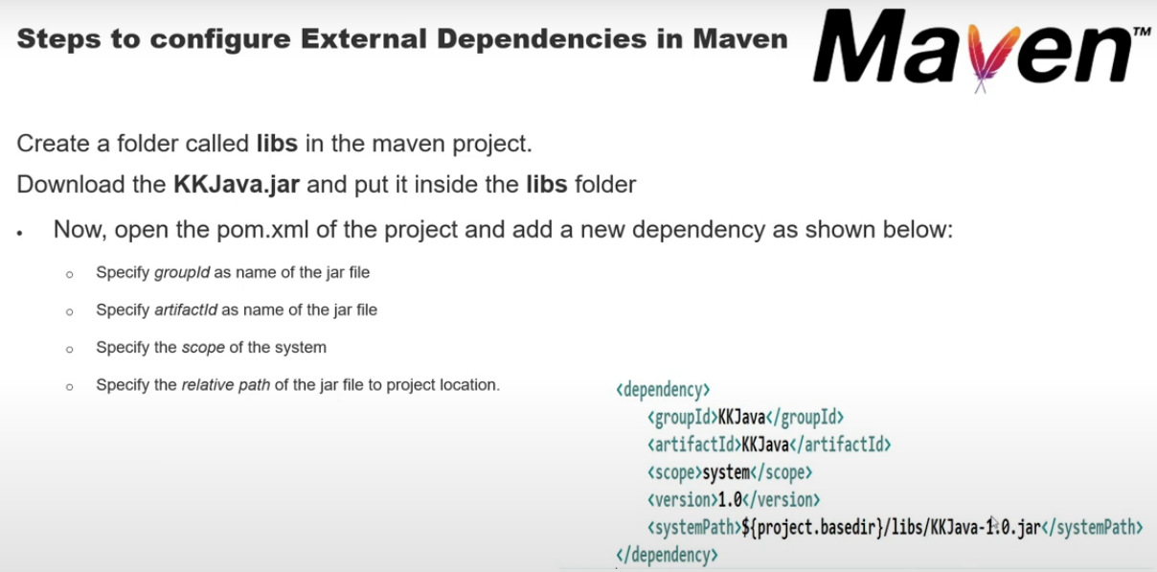

Slide 39
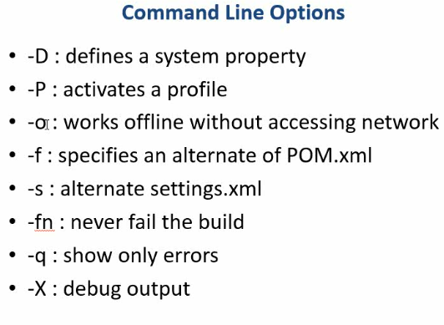
Command Line Option

Slide 40

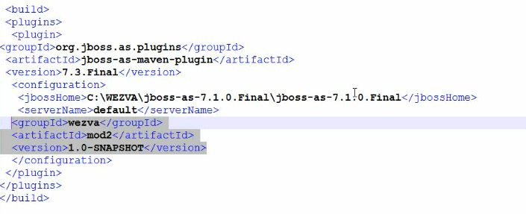
Deploy application Using Maven

Slide 41
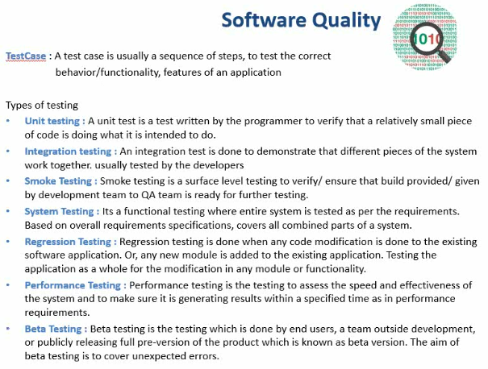
Software Quality

Slide 42
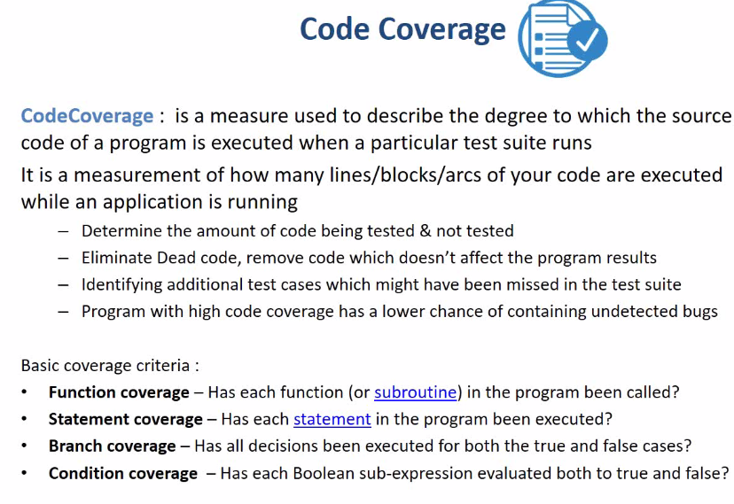

Slide 43
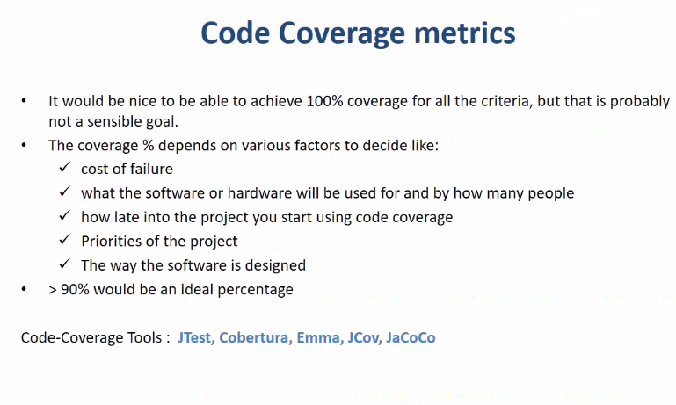

Slide 44
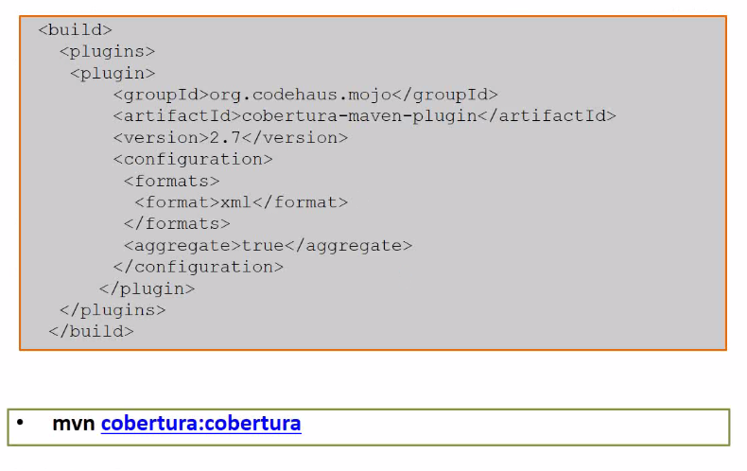
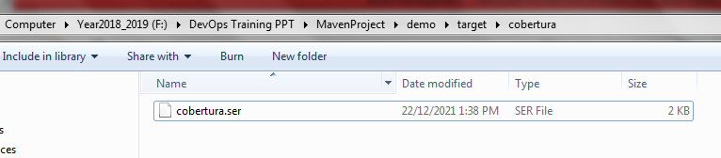
Maven Code Coverage Plugin – It will generate cobertura.ser file

Slide 45
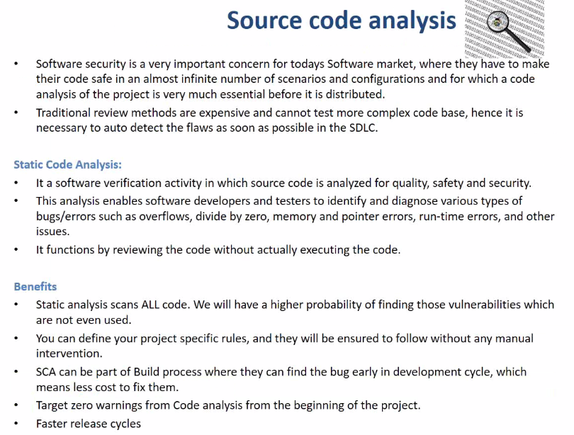

Slide 46
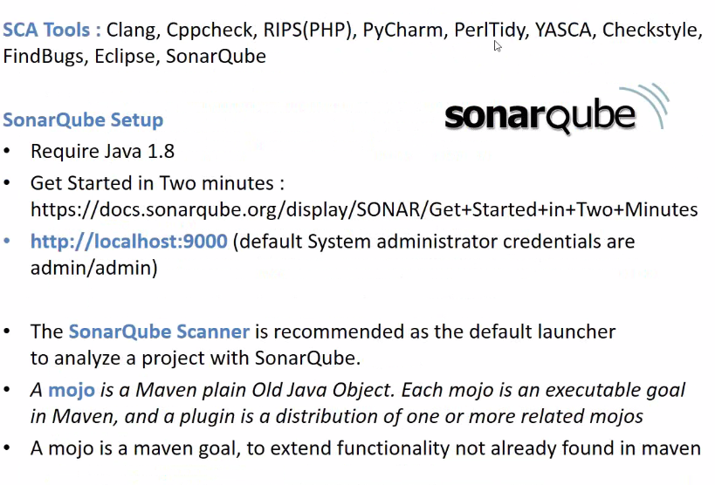

Slide 47
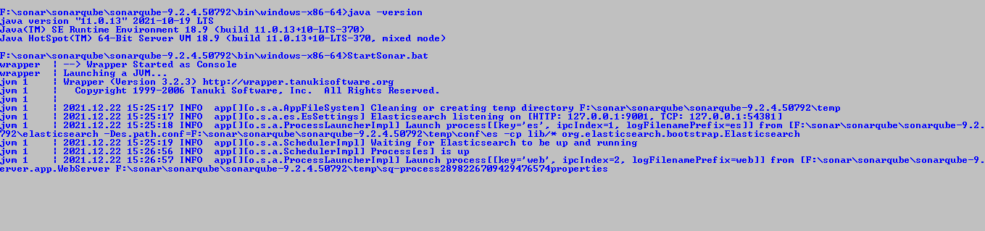
Sonarqube Installation
Download SonarQube and Extract it.
On command prompt execute command: StartSonar.bat

Slide 48
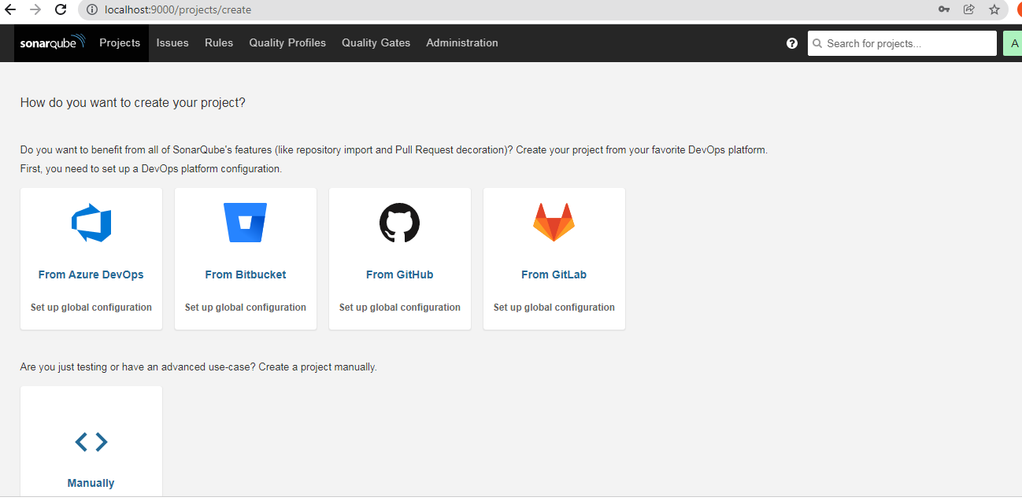

Slide 49
Sonar Scanner
https://binaries.sonarsource.com/Distribution/sonar-scanner-cli/sonar-scanner-cli-4.6.2.2472-windows.zip
https://www.c-sharpcorner.com/article/how-to-setup-the-sonarqube-on-local-machine/
https://www.c-sharpcorner.com/article/step-by-step-sonarqube-setup-and-run-sonarqube-scanner/

Slide 50
Command to Execute Scanner
sonar-scanner.bat -D"sonar.projectKey=test-key" -D"sonar.sources=." -D"sonar.host.url=http://localhost:9000" -D"sonar.login=50c0f262ee0f5907b10d87b2ccfaebc428b29bd7“
Direct Command:
mvn sonar:sonar -Dsonar.host.url=http://localhost:9000 -Dsonar.login="50c0f262ee0f5907b10d87b2ccfaebc428b29bd7"

Slide 51
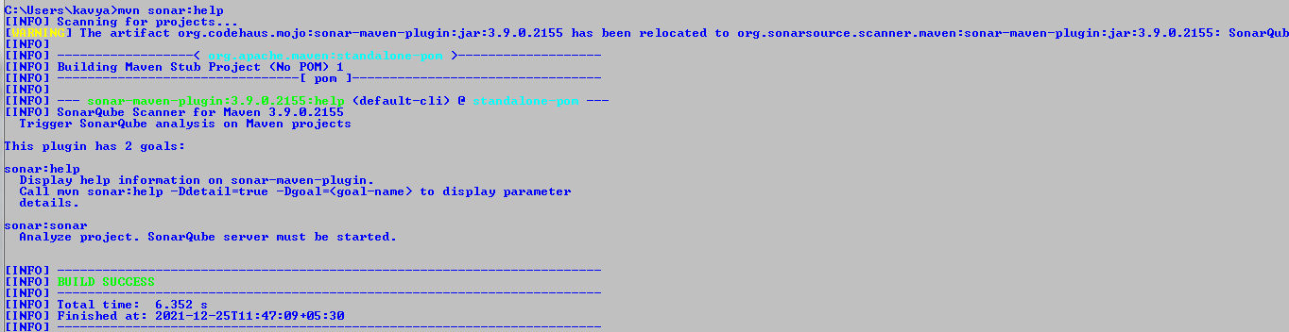
What is sonar:sonar?

